Slide 1


Project Shafafiyat
Belarusian operation on the border with Poland: use of the migrants

Slide 2
Contents
Project Shafafiyat
Discuss the reasons for the occurrence of the aggression of the Alexander Lukashenko regime (more widely, the Russian-Belarusian state) against Poland.
Explaining what Operation Sluice is all about and what demographic weapons and weponization of migration are.
Discuss the goals of Belarusian leader Alexander Lukashenko related to his use of migrants: to divide Europe and destabilize Poland.
Discussion of the use of migrants by Belarusian services.
Discuss the problem of illegal migration in the context of criminal activities. (smuggling) and presentation of legal opportunities to enter Poland.
Discuss the Belarusian-Russian modus operandi of manipulating in the international information space the image of their aggression against Poland.

Slide 3
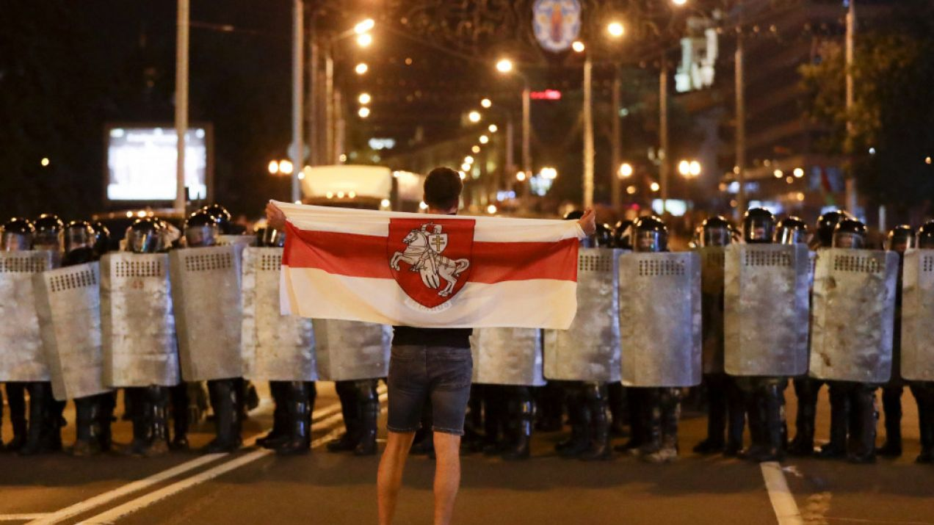
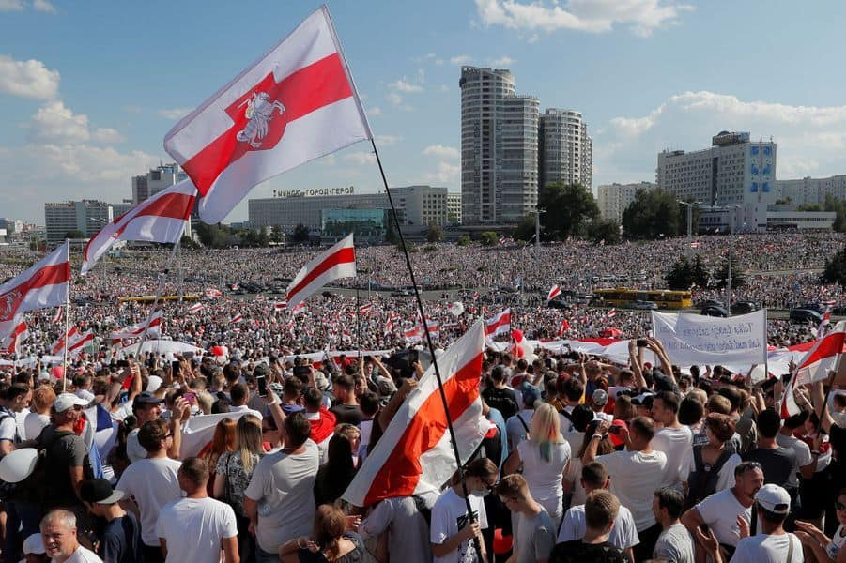
Discuss the reasons for the occurrence of the Alexander Lukashenko regime's aggression against Poland.
Project Shafafiyat
Pro-democratic turn of Belarusian society: the largest peaceful protest in Belarusian history accompanying the 2020 presidential election.
Lukashenko's bloody suppression of protests and rigging of elections.
Poland and Lithuania's support of the democratic opposition.
EU sanctions on Lukashenko's regime.
Hijacking of Ryanair aircraft, flying from Athens to Vilnius, May 23, 2021.
Russian aggression war against Ukraine.

Slide 4
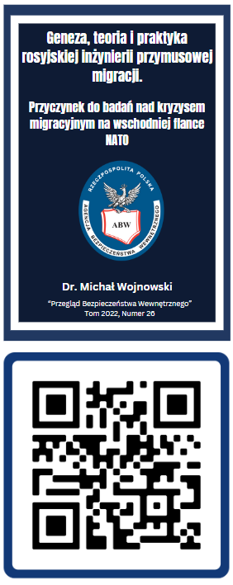

Veponization of migration
  Engineering forced migration.
  Coercive engineered migration refers to cross-border population movement that is inspired by one country and then manipulated in such a way as to induce political, military, economic and other concessions from the target country or group of such countries. The means used to initiate cross-border population movement can be many and varied.
Demographic Weapons.
Demographic Weapons can be defined as a combat tool used in asymmetric armed conflict. D-weapons are based on the use of a large group of civilians, conscious or unconscious, given armed function, as well as demographic processes, including population growth and migration. D-weapons are used to flare up, including on a massive scale, in order to produce intolerable consequences for the opponent inside and outside the state.
Project Shafafiyat

Slide 5
Operation Sluice
The concept of Operation Sluice was conceived as early as 2010-2011, at which time the Belarusian regime wanted to take advantage of the stimulation of migration toward the European Union to extort a tribute from it (under the pretext of reimbursing the costs of protecting the border from illegal migration, which it was organizing itself).
The plan to ferry migrants to the European Union was dubbed Operation "Sluice" by Russian-Belarusian services. It involved thousands of migrants trying to illegally enter the European Union through the Lithuanian-Belarusian, Latvian-Belarusian and Polish-Belarusian borders.
Project Shafafiyat
The criminal enterprise involved:
        Belarusian state enterprises (e.g. Centrkurort),
        middlemen,
        smugglers,
        airlines,
        „travel agences",
        illegal financial offices.
All these groups made money smuggling people across the border. As a result, more and more migrants were forcing their way across the Polish border.

Slide 6
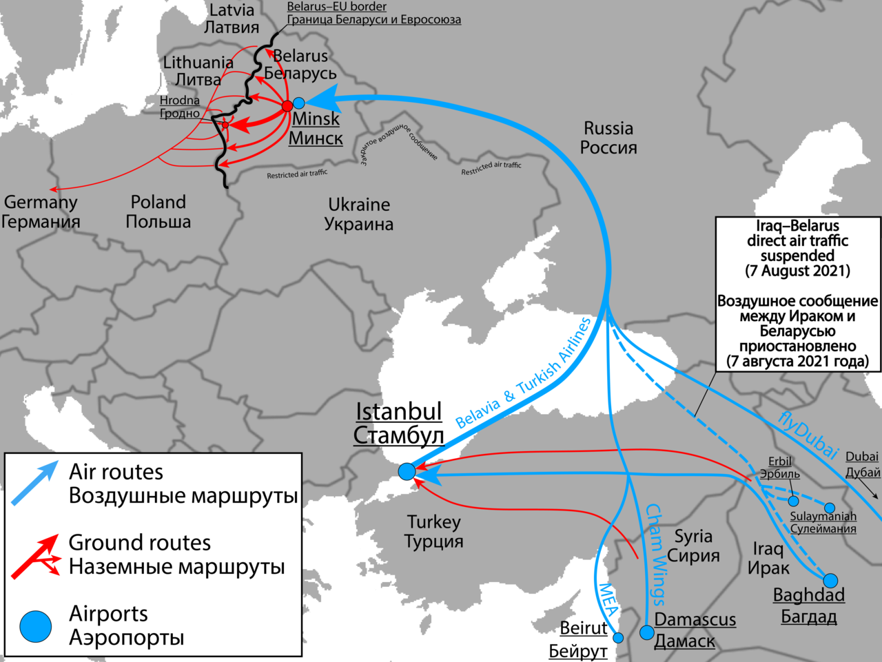
Project Shafafiyat

Slide 7
Operation Sluice
Project Shafafiyat
In doing so, the concept fits into the model of demographic weapons, i.e. the use of civilians, in the form of a migratory flow, as a weapon against another state in order to achieve specific strategic goals.
Civilians are not the attacking subject in this model, but a tool. In doing so, the goals of using demographic weapons can vary, e.g., gaining financial benefit (e.g., Turkey received €6 billion from the EU in 2015), political concessions, destabilizing the opponent, etc.
The launch of Operation Sluice, the use of people brought in from Iraq, among others, as weapons, was Lukashenko's response to these EU actions. The immediate goal was to force the European Union to withdraw its sanctions, stop supporting the Belarusian opposition, recognize the legitimacy of his election and condone repression.
The paradox was and still is that migrants attempting to cross the border illegally and claiming to be refugees (although, except in a few cases, they did not meet the prerequisites for being recognized as such) became the very tool to be used against those who were actually being persecuted - Belarusian oppositionists..

Slide 8
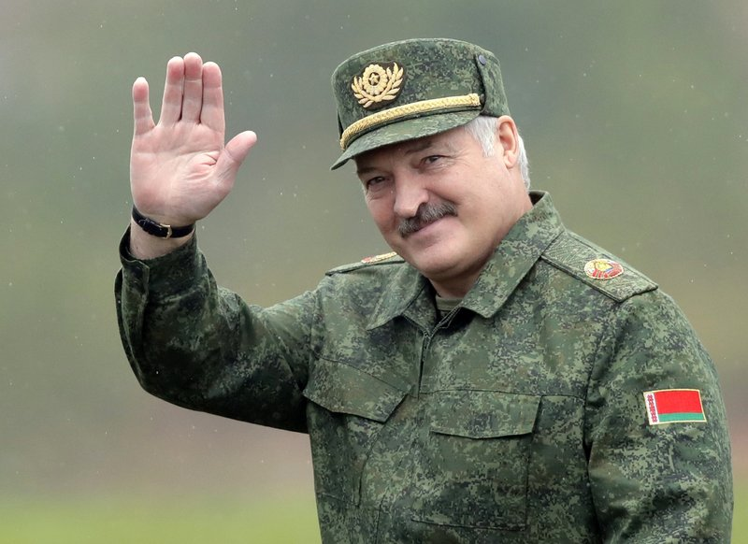
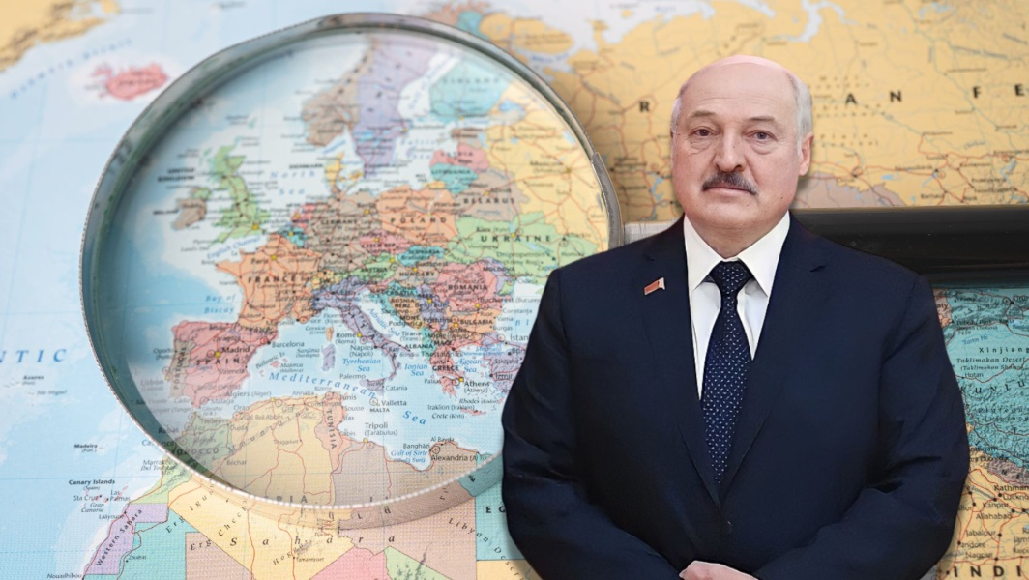
Goals of Belarusian leader Alexander Lukashenko
Goals:
earnings
Forcing the European Union to withdraw from sanctions,
stop supporting the Belarusian opposition,,
recognition of the legitimacy of his election
permission for repression
increasing the popularity of radical groups (and pro-Russian ones at that, such as the far-right AFD in Germany) in Poland and Europe
distortion of the image of refugees and discouragement of acceptance of war refugees
destabilization of political and social life in Europe
divert attention from Russia's actions on the border with Ukraine
discredit Poland in the eyes of international opinion
lead to an internal crisis in Poland (and Lithuania) through social polarization and undermining trust in state institutions
Project Shafafiyat

Slide 9
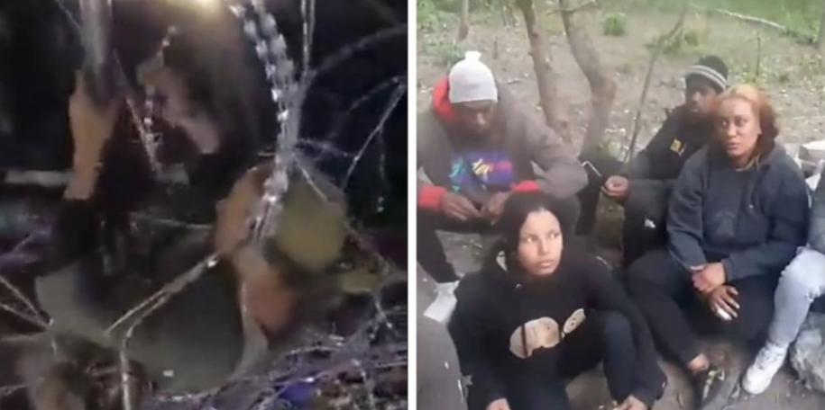
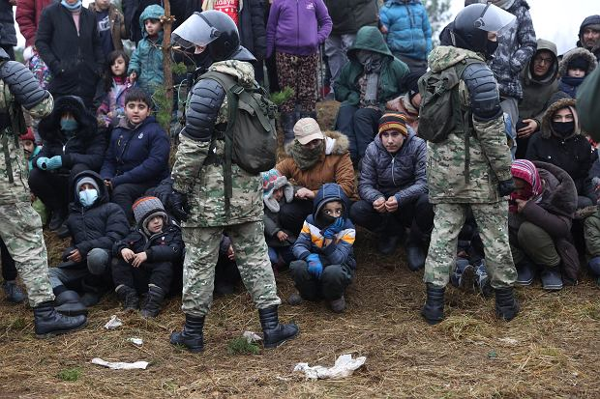
Exploitation of migrants by Belarusian services
Dangers created by Belarus:
Fraud by smugglers, extortion of money, looting, destruction of personal belongings.
Physical violence: beating, rape, pushing on concertina (wires) , pushing into dangerous areas, such as rivers.
Failure to provide help.
Beating almost to death, and then pushing to the Polish side so that the person would die there, and the blame would fall on Poland.
Belarusian services are pursuing the incident at all costs, including the price of the lives of those they brought in. They take advantage of their situation and pay them to provoke them against Polish border guards and soldiers.
Project Shafafiyat

Slide 10
Illegal migration in the context of criminal activities
Polish border with Belarus is the external border of the European Union and Poland is obliged to guard it. Poland, on the other hand, is fulfilling its international obligations. Therefore, even if someone manages to cross the border illegally and does not drown in the marshes or freeze in the woods in the process, he will most likely be stopped on his way to the German border.
For Poland, illegal migrants to leave the territory of Poland and enter another EU country is not "getting rid of the problem."
First, because Poland is a serious country that takes its laws seriously, as well as its international image.
Secondly, because migration through Poland to other EU countries poses the threat of having to change the rules for crossing internal EU borders in the Schengen area and reintroduce border controls.
Thirdly, because according to bilateral agreements and European Union regulations, foreigners who illegally cross the Polish-German border are subject to readmission, i.e. withdrawal from the destination country to the first European Union country whose border they crossed. That is, in this case, to Poland. Here, on the other hand, they will be placed in a closed center and then deported if they do not meet the criteria for recognition as refugees.
Project Shafafiyat

Slide 11
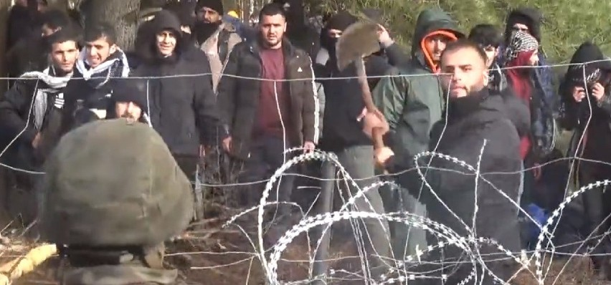
Illegal migration in the context of criminal activities
Illegal border crossing carries a prison sentence for up to 3 years.
For organizing such crossing - a prison sentence of up to 8 years.
For assaulting a border guard, can be sent to prison for up to 12 years before being deported.
Regardless, people deported for illegally crossing the border are banned from entering Poland and the EU (Schengen countries). Such a person will no longer be able to come legally, and opportunities for legal entry exist.
Project Shafafiyat

Slide 12
Legal options for entering Poland
Project Shafafiyat
Thousands of Iraqi citizens, as well as other Middle Eastern countries, enter Poland legally every year. They are tourists, students, workers, etc. They are welcomed because they come legally. From the beginning of 2021 to mid-2023. Poland also issued about 570 temporary or permanent residence permits for Iraqi citizens. However, the more attempts there are to cross the border illegally, the more difficult it will be to enter legally as well.
Poland also accepts refugees, and not only from Ukraine. For example, in 2022, 10,000 foreigners applied for international protection in Poland (this does not include most Ukrainians, as they benefit from a different procedure, i.e. temporary protection), including 639 from Iraq.
Over the past few years, Poland has granted international protection to some 150 Kurds from Syria, Iran or Turkey. In 2022. 20 Iraqi citizens applied for permanent residency in Poland, 2 applied for long-term EU resident status, and 277 applied for temporary residency. At the same time, Poland issued 19 positive decisions on permanent residency, 7 - negative, 2 cases were discontinued and 1 was left undetermined.
Jeżeli chodzi o rezydentów długoterminowych UE to wydano tylko 1 decyzję negatywną, natomiast jeśli chodzi o pobyt czasowy to pozytywną dostało 181 osób, 47 – negatywną, 6 spraw umorzono, a 23 pozostawiono bez rozpoznania.
It is clear that Poland does not discriminate against anyone and is not closed to Iraqi citizens, provided that they abide by Polish law and their arrival and stay is legal.

Slide 13
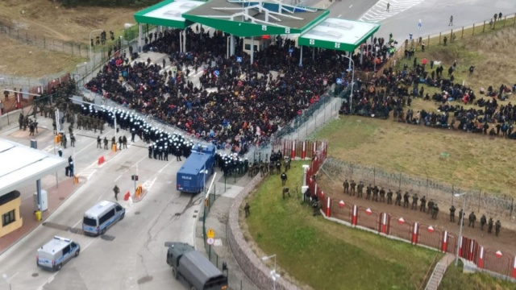
Belarusian-Russian modus operandi of manipulating the image of its aggression against Poland in the international information space
Belarus and Russia meticulously use precisely selected information material, and if they do not have it, they manage field activities and the behavior of foreigners so as to produce it.
Active measures of Belarusian services accompanying migration pressure against the RP:
Listening
Observation
Reconnaissance of Polish Border Guard activity
Planning (time and place) of migrant smuggling
Dislocation of immigrants
Coordination of the location in the border area
Destruction of the physical barrier
Semblance / confusion
Staging
Provocations
Disinformation
Information activities
Project Shafafiyat

Slide 14
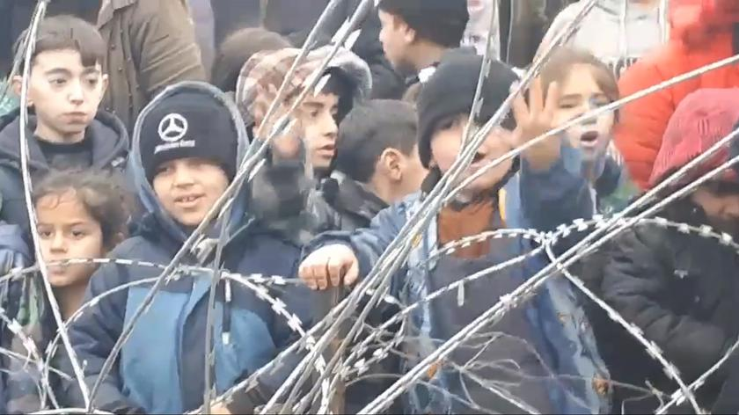
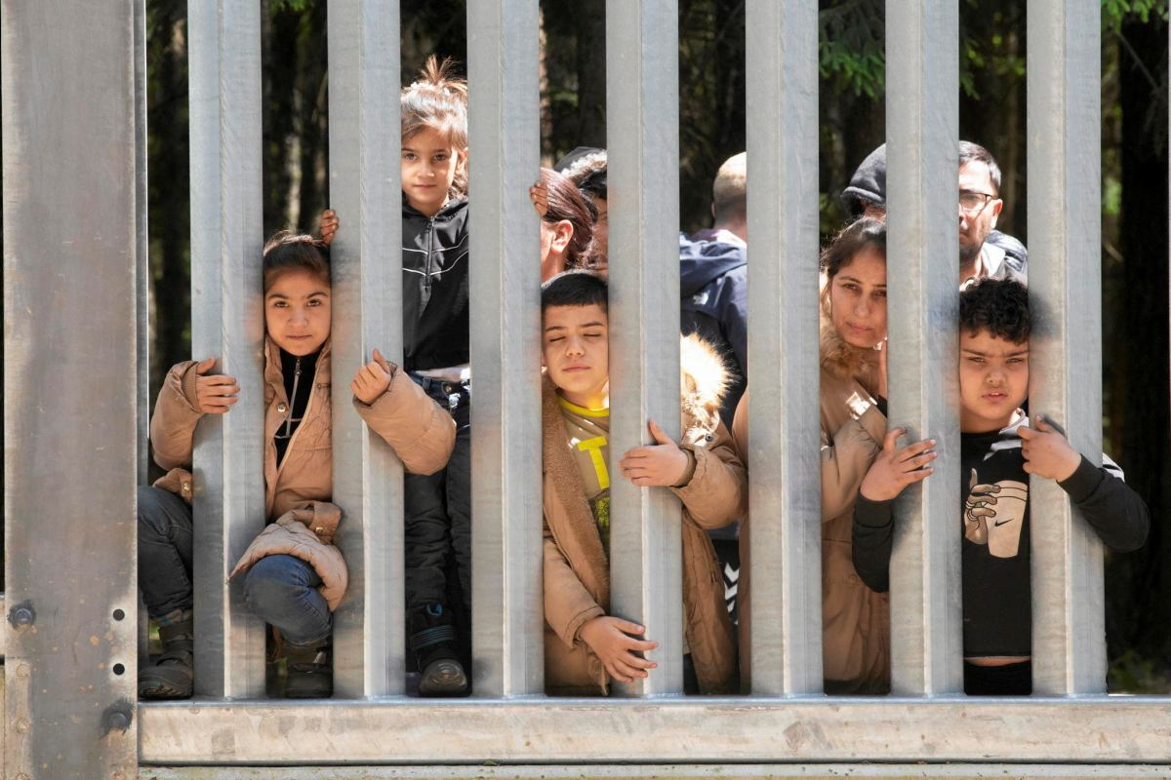
Belarusian-Russian modus operandi of manipulating the image of its aggression against Poland in the international information space
Project Shafafiyat
The exposition of harm began by showing suffering animals that perished when confronted with fences (concertinas) erected by soldiers. When the hysteria surrounding the subject failed in deepening polarization, the harm to children and defenseless women was put at the forefront of the propaganda.
Poland is measuring itself against the actions of an adversary that bases many of its actions on empathy, which is a very strong and primal human trait. It is not easy to counter selective information and manipulated or fake events that evoke sympathy in the audience. The international public should be widely informed that these emotions are being evoked in them by specific countries (Russia, Belarus) and for a specific purpose.

Slide 15
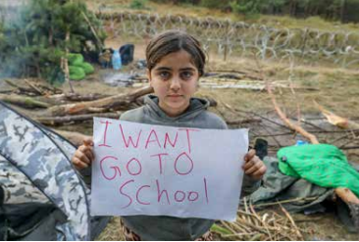
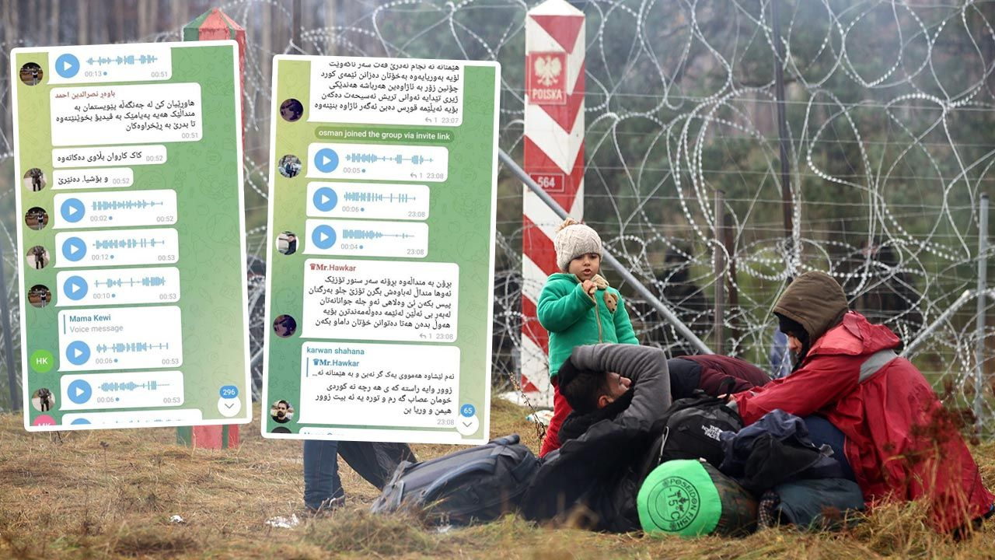
Belarusian-Russian modus operandi of manipulating the image of its aggression against Poland in the international information space
More instructions from Belarusian services, more recordings of propaganda material. Children are exposed to stir up even more emotions:
https://twitter.com/Straz_Graniczna/status/1458834075662405636
https://twitter.com/Straz_Graniczna/status/1458834476310671361
https://twitter.com/Straz_Graniczna/status/1458834730347020293
Migrants tempted by Belarusian services blow cigarette smoke into a child's eyes to induce tears:
https://twitter.com/VoicesBelarus/status/1457705413898604545
If any children know even a word of English they are included in propaganda activities. "Messages in foreign languages are a huge benefit," "Give children banners, write slogans on humanitarian issues.„
https://twitter.com/StZaryn/status/1458769057902178311
https://twitter.com/StZaryn/status/1458774680064643077
Project Shafafiyat

Slide 16
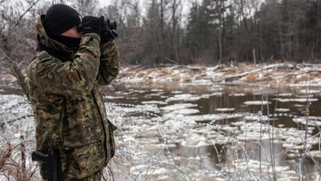
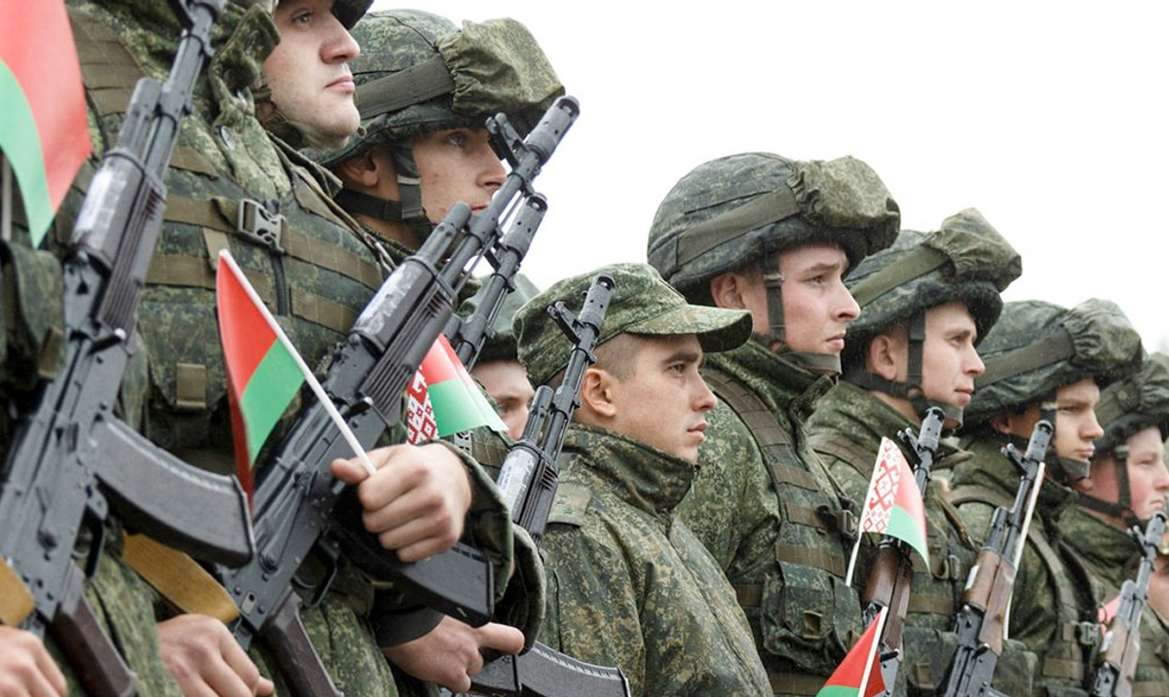
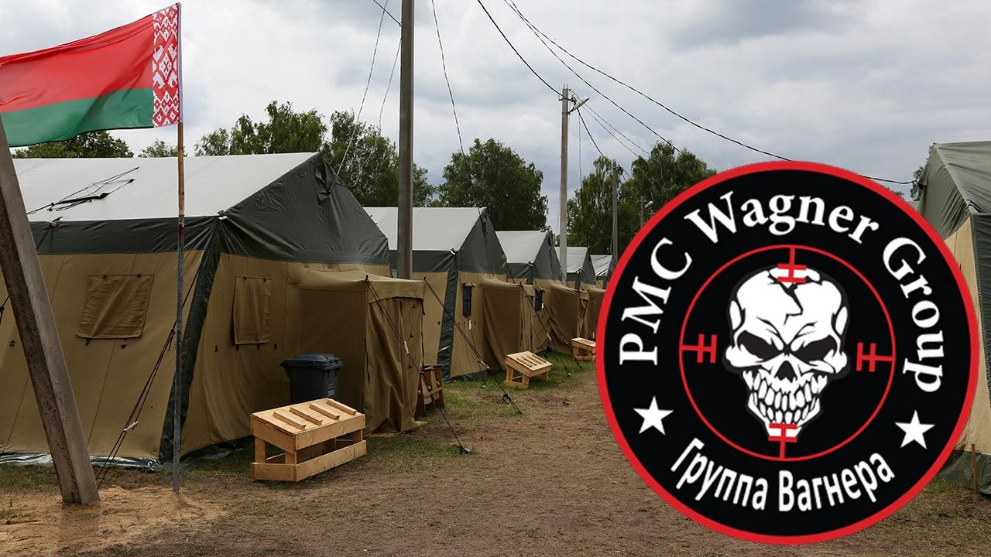
Belarusian-Russian modus operandi of manipulating the image of its aggression against Poland in the international information space
From the Belarusian side, there are attempts to subject Polish officers to psychological pressure:
firing empty shots,
throwing objects in the direction of the Border Guard,
moving around with sniper rifles of Belarusian "border guards",
threatening to harm/rape women and/or children in front of Polish services.
These are actions calculated to create pressure, including provoking Polish officers to cross the border or get into physical confrontations.
With an operation conducted in this way, the enemy's services gain as much information as possible about how to respond in a foreign country. It sounds vague, but the border line consists of a specific territory, differently shaped and supervised - in addition to electronic means, there are teams of the Border Guard or the Polish Army on the spot. Each patrol, reconnaissance activity, response time and decision can be stimulated by Belarus with the onslaught of immigrants, and the response of Poles - subjected to exhaustive analysis. This type of threat does not only have a social dimension, as there are often planning and reconnaissance processes in the background, often with a violent dimension.
Project Shafafiyat

Slide 17
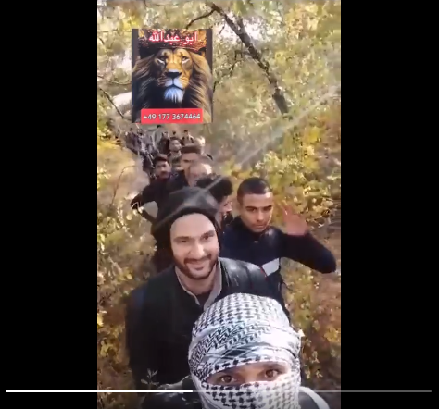
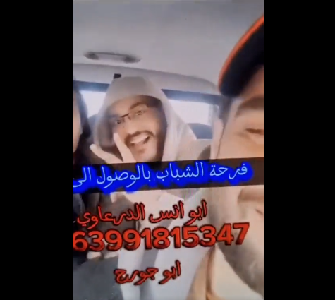
Belarusian-Russian modus operandi of manipulating the image of its aggression against Poland in the international information space
Since the beginning of the Belarusian operation, a wave of videos encouraging the Arab-speaking population to come to the European Union has also appeared online.
The videos suggested and continue to suggest that crossing more borders illegally is easy and pleasant. They show smiling men listening to music as they traverse one green forest after another.
The disseminated videos of immigrants achieve two goals. First, they are a certain form of advertising and lure more foreigners. Encouraged by such content, they enter the whole "tourist" cycle. It begins with dislocation, and then we have incarceration in a Belarusian hotel, transportation to the border, and finally being forced by Belarusian border guards under physical pressure to enter the Republic.
The second purpose of circulating such recordings is to divert attention from the fact that Alexander Lukashenko's regime is behind the whole procedure. Public attention is momentarily focused on companies, organizations or groups that are in the business of encouraging migration and helping people cross the border. Of course, such commercial business is taking place, but it is not, after all, happening without the support, approval and supervision of the Belarusian services.
Project Shafafiyat

Slide 18
Project Shafafiyat
Project Shafafiyat
Szaffaf/szaffafiat (transparency) – An educational project that aims to build resilience against foreign propaganda operations in the Iraq and Kurdistan region.
OUR MISSION
الشفافية | شەفافیەت
One of the tasks of the Shaffaf project is to bring the audience closer to the real intentions and active actions of the Russian Federation and the Republic of Belarus taken in the area of the Global South, with a particular focus on Iraq, including the Kurdistan region.
WWW: https://shafafiyat.com/
TELEGRAM: https://t.me/shafafiyat_int
FB: https://www.facebook.com/shafafiyat/
X: https://twitter.com/ProjectShaffaf

Slide 19

Project Shafafiyat
Project Shafafiyat
Public task financed by the Ministry of Foreign Affairs of the Republic of Poland within the grant competition “Public Diplomacy 2023”
The opinions expressed in this publication are those of the authors and do not reflect the views of the official positions of the Ministry of Foreign Affairs of the Republic of Poland.

