Slide 1
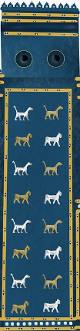

Project Shafafiyat
Russian aggression war against Ukraine

Slide 2
Contents
Project Shafafiyat
The reason for the Russian aggression war in Ukraine
Russia and the territorial integrity of Ukraine
Russia's security at risk?
Russia as a colonial empire
Ukrainians and independence
From hybrid war to invasion
Russian lies
Russian war crimes
Russian attempts to attribute its own actions to others
Conquest and Russification
Poles and Ukrainians
Peace
The war in Ukraine and Russian manipulation techniques
Western aid to Ukraine
Putin's "merits" for Russia
Russian vision of the world: "pride steps before the fall"

Slide 3
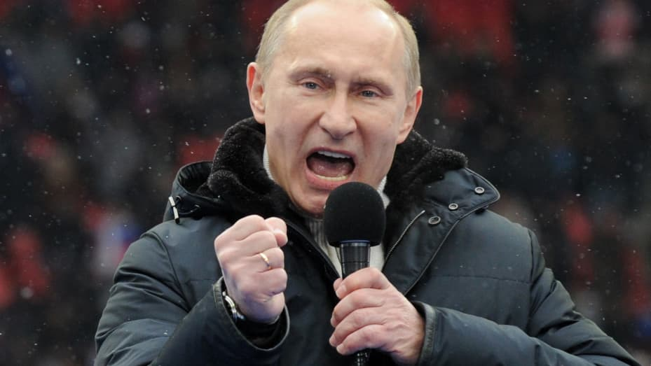
The reason for the Russian aggression war in Ukraine
Project Shafafiyat
Putin: The collapse of the USSR was a national catastrophe that tore and ripped alive our national unity ...
The British might as well have written this about the breakup of their Empire!

Slide 4
The cause of the Russian aggression war in Ukraine
Project Shafafiyat
1. imperial-colonial character of Russia
2. attempt to rebuild the Empire within the borders of the 19th century.
3. lack of respect for the sovereignty of other states
4. false narrative

Slide 5
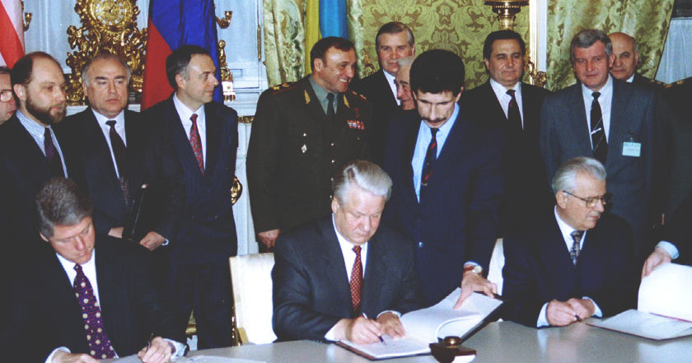
Rosja a integralność terytorialna Ukrainy
Gdy ZSRR rozpadł się w 1991 r. Rosja nie zgłosiła żadnych pretensji terytorialnych wobec Ukrainy
W 1994 r. Rosja udzieliła gwarancji integralności terytorialnej Ukrainie w zamian za dobrowolne oddanie jej potencjału nuklearnego, który był w posiadaniu Ukrainy.
Project Shafafiyat

Slide 6
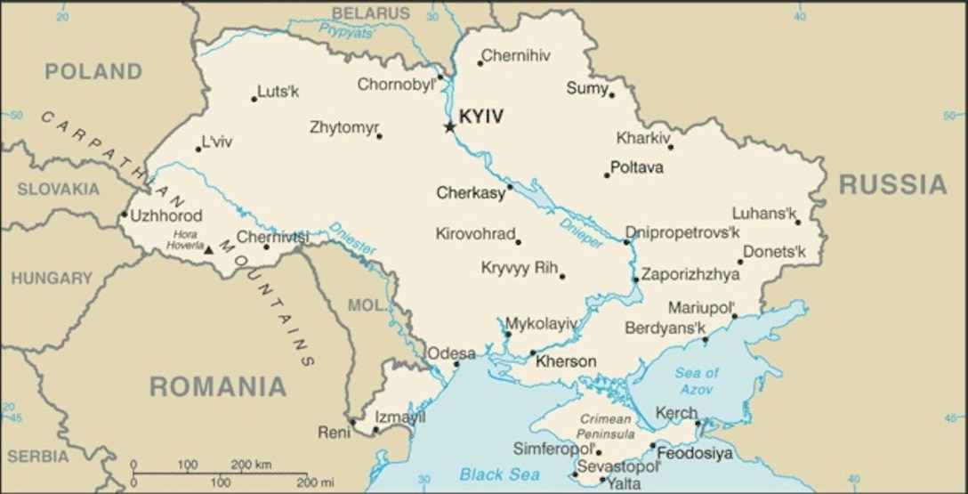
Russia and the territorial integrity of Ukraine
Until 2014, there was no separatism in Ukraine's eastern regions, and Crimea was granted the status of an autonomous republic as part of a compromise accepted in 1991.
Separatism in Ukraine was artificially induced as part of Russian imperial policy.
Project Shafafiyat

Slide 7
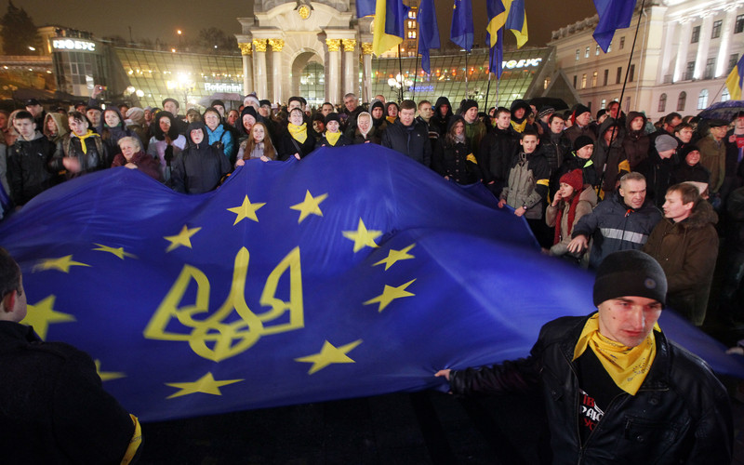
Where did the separatism come from?
Ukrainians wanted democracy and freedom and integration into the European Union. There was no prospect of Ukrainian membership in NATO.
Russia has decided to punish Ukraine!
Project Shafafiyat

Slide 8
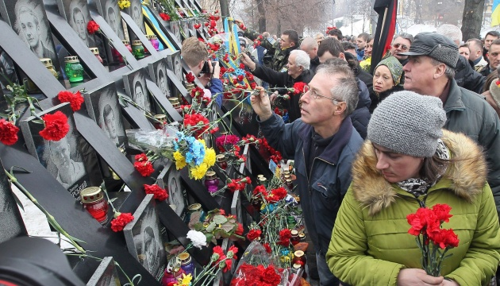
„Heavenly Sotnia”
Between December 2013 and February 2014, Ukrainian dictator Viktor Yanukovych's forces slaughtered 110 protesters in downtown Kiev. Ukrainians chased away Yanukovych, who fled to Russia.
Russia decided to take revenge and seized Crimea and organized a separatist rebellion in eastern Ukraine!
Project Shafafiyat

Slide 9
Russia's security threatened?
Project Shafafiyat
Neither Ukraine nor any other country has given Russia any reason to fear for its security.
Since the end of World War II in 1945. Russia has not been invaded by anyone, although it has done so repeatedly.
The Russian-dominated USSR occupied, among others, Poland from 1945 to 1993, invaded Hungary in 1956 and Czechoslovakia in 1968, not to mention the invasion of Afghanistan and many other imperial-colonial aggressions.

Slide 10
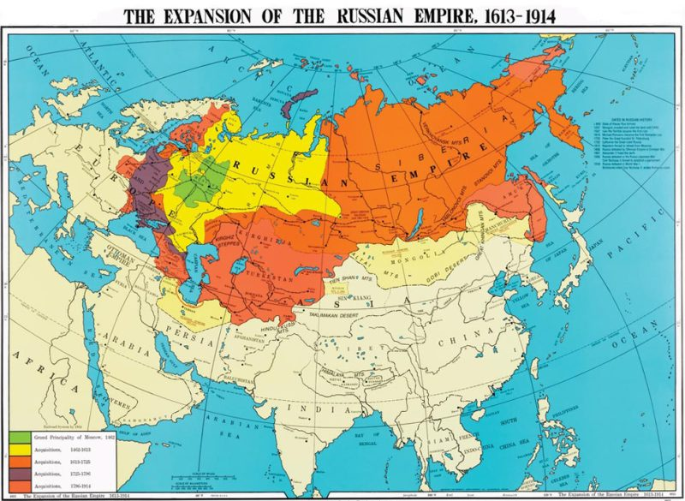

Slide 11
Russia as a colonial empire
Project Shafafiyat
Russia has conquered and oppressed other nations throughout its history
Central Europe, including Poland and Ukraine, was occupied by Russia for a long time
Despite the many wrongs suffered, the countries that liberated themselves from Russia's yoke wanted to have good, partnership relations with Russia but Russia was not interested in doing so
Russia's non-Russian territories such as Buryatia, Chechnya, Tatarstan, Kalmykia are Russian colonies

Slide 12
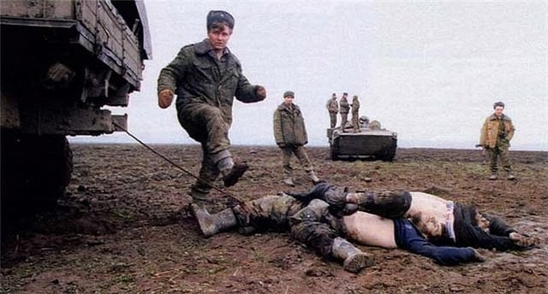

Slide 13
Russia as a colonial empire
( battles with Muslims)
Project Shafafiyat
Conquest of the Crimea in the 18th century.
The conquest of the Caucasus in the 19th century.
The war in Chechnya in the 20th century.
The invasion of Georgia in the 21st century.
Persecution of Muslims in Russia - there are barely 4 legal mosques in Moscow out of 2.5 million Muslims

Slide 14
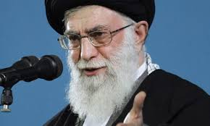
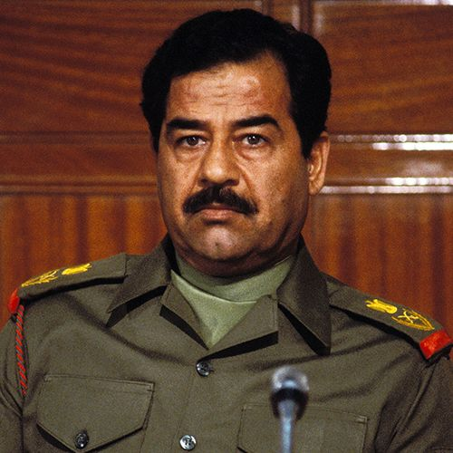
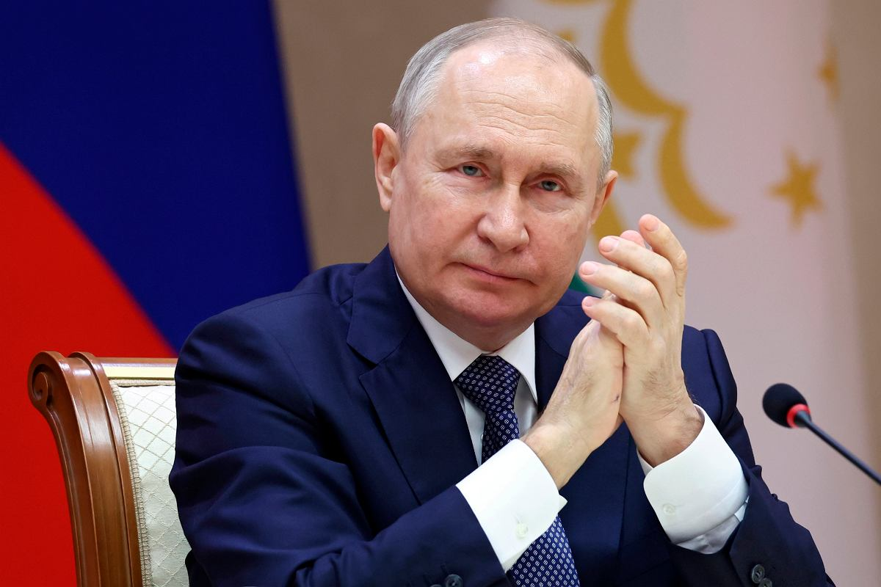

Slide 15
Russia as a colonial empire
Project Shafafiyat
Russia has a long tradition of supporting bloody dictators.
It supported Saddam Hussein to the end, and today uses Iranian drones against Ukrainians.
Putin compared its invasion of Ukraine to the U.S. invasion of Iraq, thus admitting that it is illegal.

Slide 16
Ukrainians and independence
Project Shafafiyat
In the referendum held at the time, 90% of voters voted for independence, with a turnout of 84%. In Ukraine's now Russian-occupied regions, 84% in Luhansk region, 77% in Donetsk region, 90% in Kherson region and 54% in Crimea voted for independence.

Slide 17
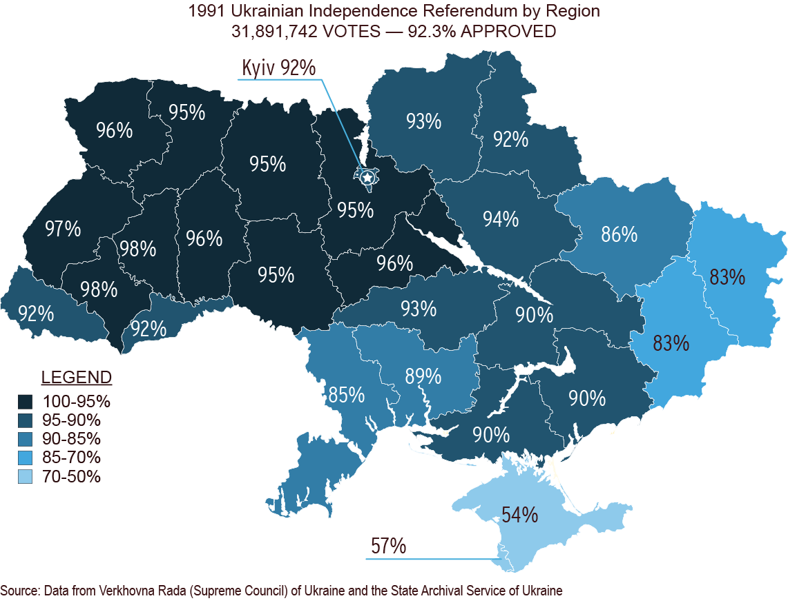

Slide 18
From hybrid warfare to invasion -.
- basic facts
Project Shafafiyat
Russia invaded Ukraine back in 2014 and has been at war ever since.
February 24, 2022. Russia launched a full-scale invasion of Ukraine.
Ukraine has no territorial claims to Russian territory and does not want to change Russia's power and interfere in its internal affairs.
Meanwhile, Russia has usurped such a right over Ukraine.
By what right?

Slide 19
Russian lies
Project Shafafiyat
The invasion has been accompanied by Russian propaganda lies from the beginning:
Russia claims it is defending itself but it has not been invaded by anyone.
Russia claims it is fighting not Ukrainians but a "regime" but this "regime"
was elected by Ukrainians in democratic elections and enjoys its support.
Russia claims that Ukraine never existed but this Ukraine existed before there was even a Russia.

Slide 20
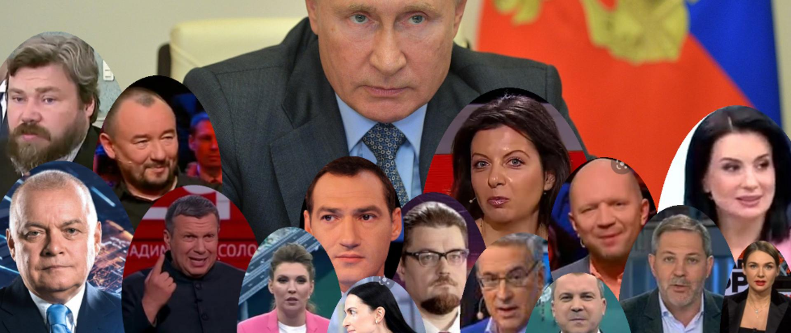

Slide 21
Russian lies
Project Shafafiyat
Russia cynically exploits the negative historical experience of the Middle East and seeks to prey on resentments directed against former European colonial powers and the US.
Being a partitioned empire, it tries to present itself as an anti-imperial force.
Russia says Ukrainians are "brothers," and it once said the same about Poles. But no superpower can command another nation to love it and consider it a friend or brother, threatening otherwise with murder.

Slide 22
Russian war crimes
Project Shafafiyat
March 2022. Russia carried out massacres of civilians in Irpen, Hostomel and Bucha.
400 people were killed based on previously prepared proscription lists.
It was a genocide! However, there were more crimes!

Slide 23
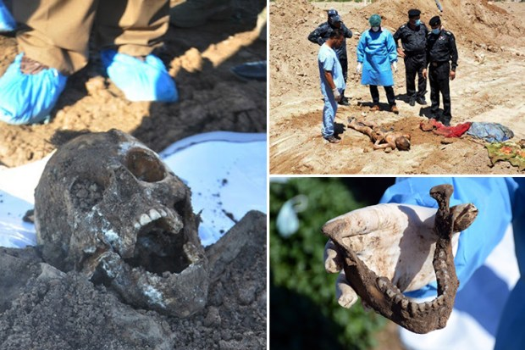
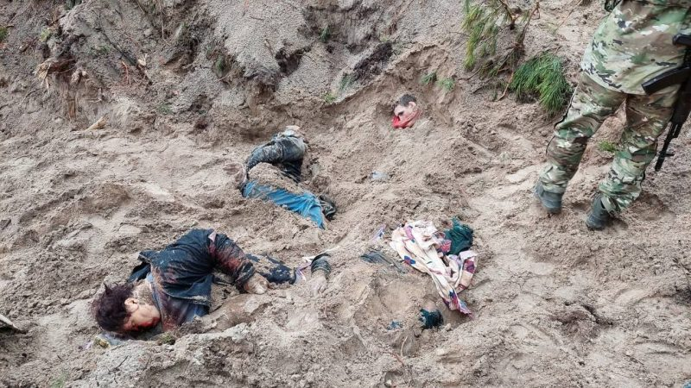
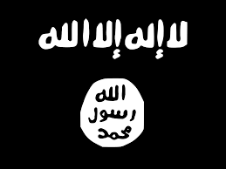

Sinjar
2014
Bucza 2022

Slide 24
Russian war crimes -
- Wagner's group: the Russian Daesh
Project Shafafiyat
The most atrocious crimes are carried out by Russian mercenaries, the so-called "Wagnerians," whose cruelty is not far behind that of Daesh. Among other things, they have carried out public executions by crushing heads with hammers.
Daesh wanted to blow up the dam in Mosul, and the Russians partially blew up the dam in Novaya Kakhov
There are more similarities!

Slide 25
Russian war crimes -
- kidnapping of children
Project Shafafiyat
Like Daesh in Iraq, the Russians abducted children from Ukraine to change their identities.
This fate has befallen as many as 700,000 Ukrainian children.
For this crime, Russian dictator Vladimir Putin and his aide Maria Lvova-Belova are being prosecuted by the International Criminal Court.

Slide 26
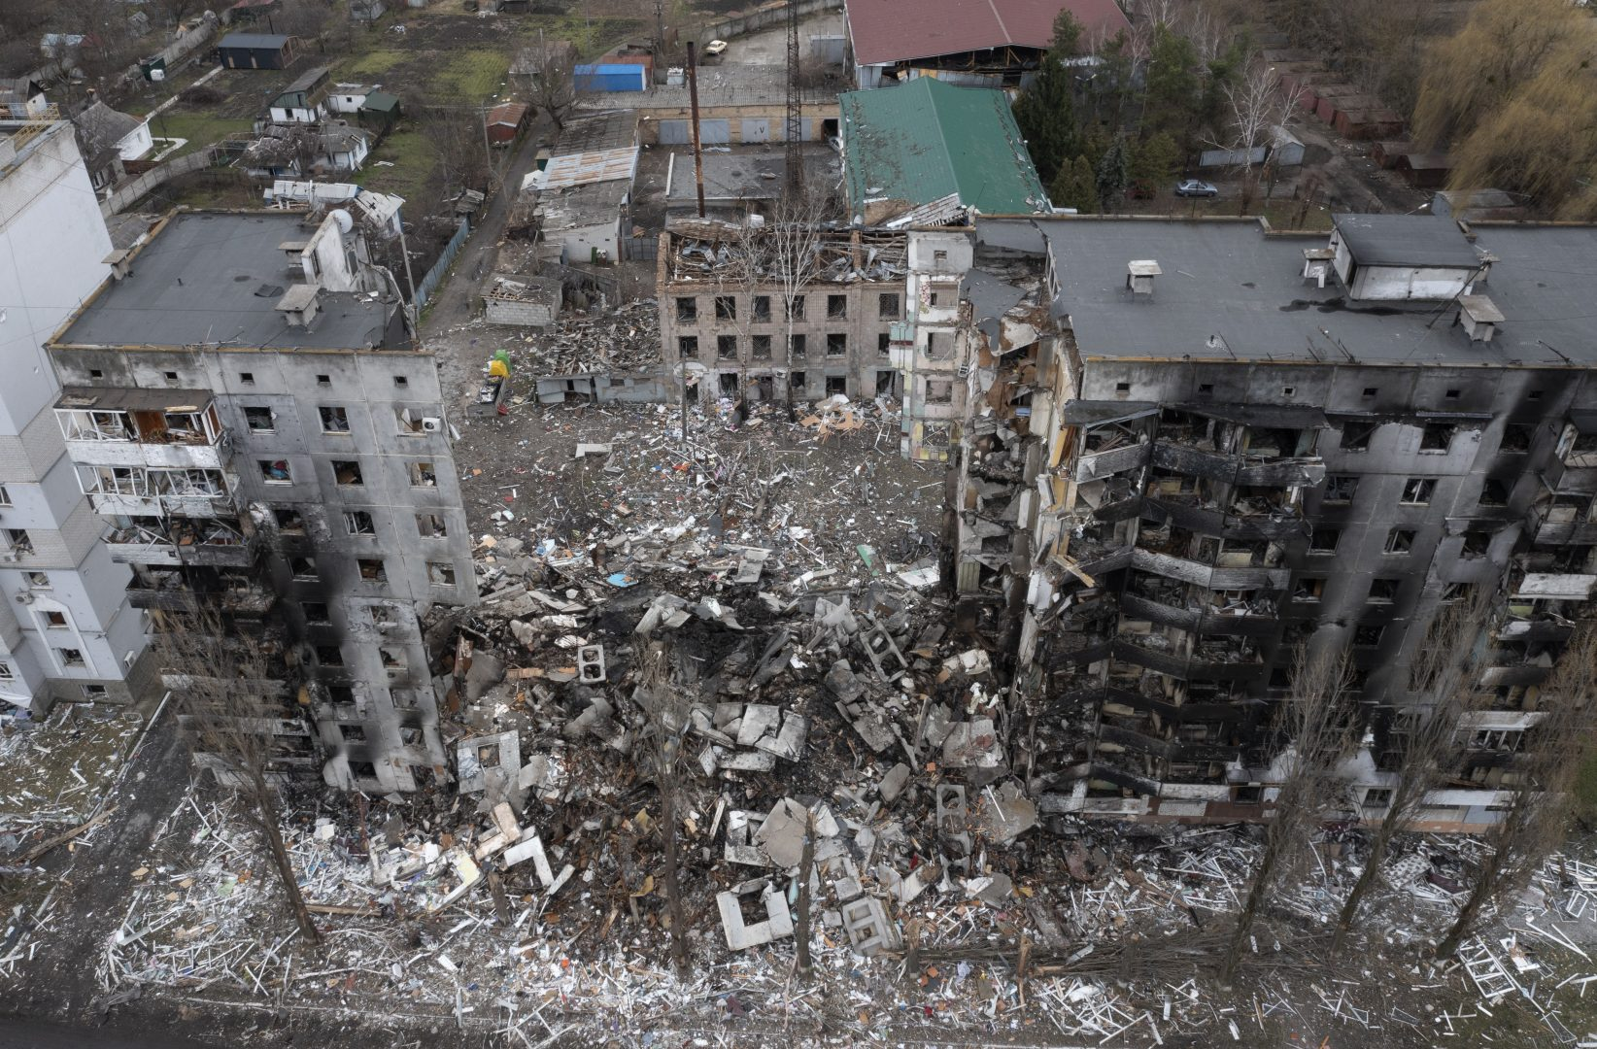
Russian war crimes -
revenge for defeats
Project Shafafiyat
Such assaults on civilians intensified when Russia realized it would not take Kiev, and Ukrainian forces pushed the aggressor out of Kherson.
So Russia did what it does best - murder defenseless civilians!

Slide 27
Russian attempts to attribute its own actions to others
Project Shafafiyat
Falsely accusing Poland of wanting to seize western Ukraine
Cynical suggestion that Russia is fighting "bandits" in Ukraine (Bandera fought Poles)
Poland (unlike Russia) bases its relations with its neighbors on peaceful methods, not on brutal violence
Russian attempts to divide Poles and Ukrainians continue but are ineffective

Slide 28
Conquest and Russification
Project Shafafiyat
Ukraine found itself within Russia's borders as a result of imperial conquest in the 17th and 18th centuries, as did Poland somewhat later.
Intense Russification and the 19th century policy of denationalization had an effect, albeit limited.
Today, Russian-speaking Ukrainians suffer just as much from Russian aggression as those who speak Ukrainian.

Slide 29
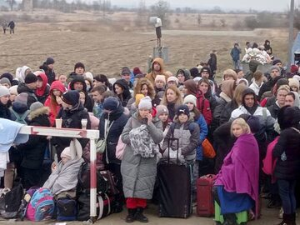
Poles and Ukrainians
Since the beginning of the war, more than 15 million Ukrainians have crossed the Polish border, mostly women and children. True, most have returned to Ukraine but there are still several million refugees from Ukraine in various European countries.
Most, about 2 million, await the end of the war in Poland.
Project Shafafiyat

Slide 30
"Peace" according to Russia
Project Shafafiyat
Russian aggression has already killed some. 200-250,000 people, and hundreds of thousands are injured.
The blockade of Ukrainian ports has caused food problems in many countries.
For Russia, the word peace means unconditional surrender of Ukraine, which would submit to Russia's imperial and colonial voracity.

Slide 31
Peace conditions
Project Shafafiyat
Russia's withdrawal to the 2014 borders.
Its commitment to respect the sovereignty and territorial integrity of its neighbors.
These are not exorbitant demands!
After all, no one is calling for the dismantling of the Russian colonial empire although that would be just as fair as dismantling the British or French colonial empires.

Slide 32
The war in Ukraine and Russian manipulation techniques
Project Shafafiyat
Attempting to replace the facts about the Russian assault on Ukraine with the false impression of waging a proxy war in Ukraine, defensive against the "provocative policy" of the West and NATO.
Promoting the image of Ukraine as a servile state towards the West), taking actions "on behalf of" the EU or NATO against Russia.

Slide 33
The war in Ukraine and Russian manipulation techniques
Project Shafafiyat
Given the history of the Middle East, Russia's main propaganda effort in the region is a message designed to obfuscate the Ukrainian struggle against Russian imperialism.
Attributing Russophobia to critics of Russian Federation policy to undermine the credibility of perfectly documented allegations.

Slide 34
Western assistance to Ukraine
The Ukrainians have Western support but it has been very patchy and sometimes, especially in the beginning, even symbolic.
The same was true of foreign aid when the war against Daesh was going on in Iraq.
But that did not make that war a conflict between Islam, supposedly represented by Daesh, and Western "infidels" or Iranian "apostates."
Daesh had nothing to do with defending Islam, just as Russia has nothing to do with freedom and anti-imperialism.
Project Shafafiyat

Slide 35
Putin's " credits" to Russia
Project Shafafiyat
He united Ukrainian society and the West
He expanded NATO to include Finland and pacifist Sweden.
He disposed of Russia's ground and missile forces.
He sent 600,000-700,000 Russians on eternal vacation (they escaped forced
conscription).
He made China, Iran and North Korea dependent on him.
And many other successes!

Slide 36
Russian vision of the world
Project Shafafiyat
Russia has always sought a concert of powers, that is, the division of the world into spheres of influence among a few of the strongest players as if the rest of the world did not exist.
Ukraine now faces the same challenge and imperial cruelty that Poland and Iraq had to deal with not so long ago.

Slide 37
"Pride walks before a fall".
Russia, led by chauvinism and hubris, has bared its teeth, broken its arms and is barely able to stay on its feet in a clash with a country it thought was fallen.
History once again shows us that, first of all, hubris goes before a fall.
Project Shafafiyat

Slide 38
Project Shafafiyat
Project Shafafiyat
Szaffaf/szaffafiat (transparency) – An educational project that aims to build resilience against foreign propaganda operations in the Iraq and Kurdistan region.
OUR MISSION
الشفافية | شەفافیەت
One of the tasks of the Shaffaf project is to bring the audience closer to the real intentions and active actions of the Russian Federation and the Republic of Belarus taken in the area of the Global South, with a particular focus on Iraq, including the Kurdistan region.
WWW: https://shafafiyat.com/
TELEGRAM: https://t.me/shafafiyat_int
FB: https://www.facebook.com/shafafiyat/
X: https://twitter.com/ProjectShaffaf

Slide 39

Project Shafafiyat
Project Shafafiyat
Public task financed by the Ministry of Foreign Affairs of the Republic of Poland within the grant competition “Public Diplomacy 2023”
The opinions expressed in this publication are those of the authors and do not reflect the views of the official positions of the Ministry of Foreign Affairs of the Republic of Poland.

